Slide 1

Design Patterns in Cloud Computing
Department of Computer Engineering at university of Guilan
25 Dec 2016

Slide 2
Overview
Cloud Definition
Characteristic
Deployment models
Type of Clouds
IaaS
PaaS
SaaS
TCO / ROI
Cloud Migration Plan
Design Patterns in Cloud Computing

Slide 3
Cloud Computing Definitions
Forrester
A Standardized IT capability delivered via the Internet
Metered Services
Self Service (Private Cloud)
NIST (National Institute of Standard and Technology)
A model for enabling
Ubiquitous and Convenient
On demand
Larry Ellison
Just a computer connected to a network !
Changed his mind in 2015 …

Slide 4
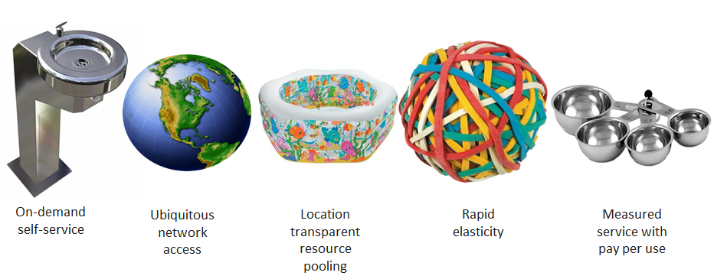
The Characteristics of Cloud Computing

Slide 5
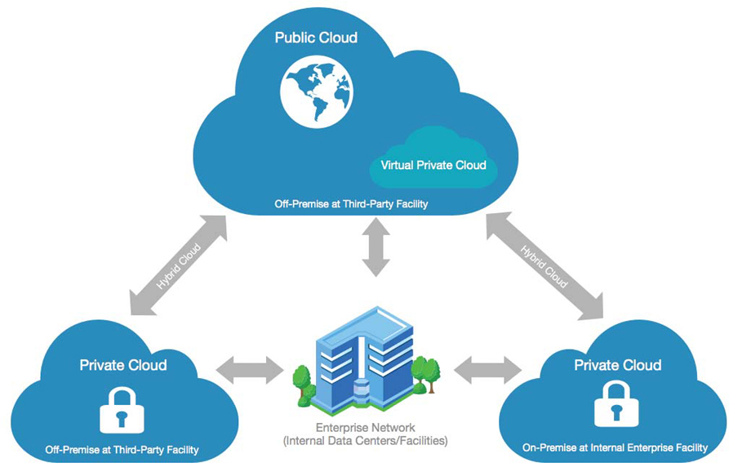
Cloud Deployment Models

Slide 6
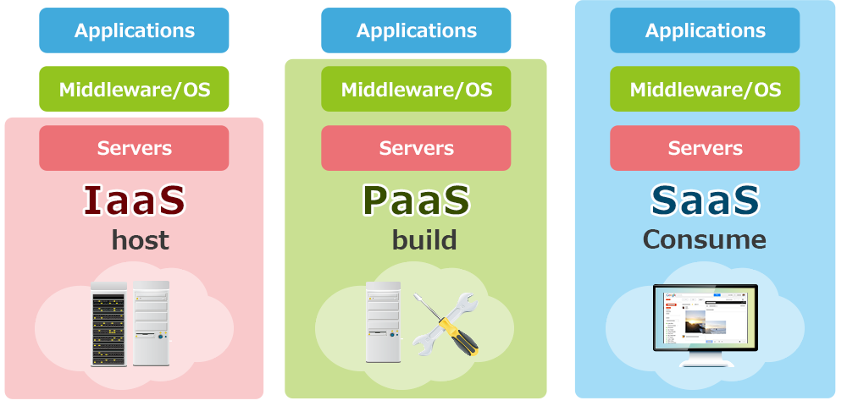
Types of clouds

Slide 7
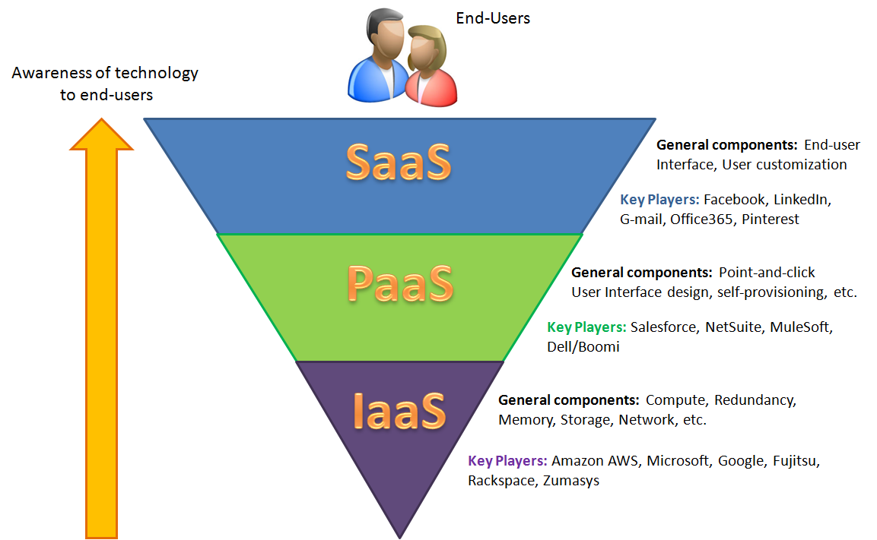
Example of Type of Clouds

Slide 8
IaaS (Infrastructure as a Service)
Provides the following:
Servers-Compute , Machine
Storage
Network
Operating System *
And all the rest which are dealing with IaaS
The user instead of purchasing servers / software or even Data Centre Space and network equipment , rent those resources as a fully outsourced services on demand-model.
IaaS can be obtained as Public , Private and combination of both
It could be Multi-tenancy.

Slide 9
IaaS (Infrastructure as a Service) Cont’d
When IaaS would be appropriate?
While demand is very volatile (Spike And Troughs)
e.g: Digikala on Yalda Night
For new enterprise
Shoestring budget
Low investment
Enterprise grows rapidly (Sudden and immediate success)
Normally scaling hardware would be problematic
e.g: Animoto (cloud base video creation)
For Specific line of business
Trial

Slide 10
IaaS (Infrastructure as a Service) Cont’d
When IaaS would be inappropriate?
Regulatory compliance in outsourcing
Data Privacy
Personal Information
Medical Information
Highest level of performance are needed
Network latency
e.g: Sanjesh Servers are located in Iran and provided by Afranet

Slide 11
PaaS (Platform as a Service)
PaaS is a computing platform that abstract :
Infrastructure
OS and Middle-ware
It helps Developer Productivity
PaaS delivers more than infrastructure
Solution stack
Machine learning (speech API)
Networking(Cloud CDN)
Management Tools (Monitoring , Logging)
Identity & Security
Storage and Database (NOSQL , RDB)
Etc

Slide 12
PaaS- Solution Stack Examples
Is a set of software subsystems or components needed to create a complete platform
No additional software is needed to support applications
Applications are said to "run on" or "run on top of“
Some common named stacks:
LAMP
LAPP
LNMP
LEAP
Ganeti
XAMPP
MEAN

Slide 13
PaaS (Platform as a Service) Cont’d
PaaS is Magic Box
Request anything on demand
Automatically build an initial environment
Provide an ability to control fault tolerance e.g : cage
Supporting , recovery nightmare
Supporting , security property to limit malicious behavior
Most important :
Do not care about how it works
Pay as you go

Slide 14
PaaS (Platform as a Service) Cont’d
Provide complete development , testing and deployment platform (environment , milestone)
Reduces the complexity of development and testing by placing the developer in a limited environment
Supported by most cloud providers , including AWS , Google and Microsoft Azure or even integrated with your PaaS build Application

Slide 15
SaaS (Software as a Service)
Is often the path to saving the most money giving what enterprise are paying today for enterprise software.
Removes the need for organizations to install and run hardware
Eliminate the waves of hardware and software acquisition
Eliminate server maintenance
Supports both desktop and mobile computing
Continuous automatic updates

Slide 16
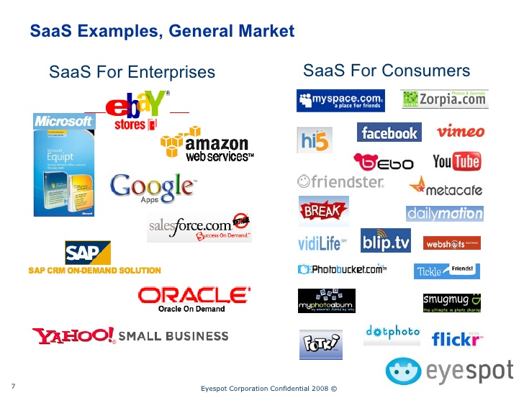
SaaS Examples
There are more than 2000 software as a service
Salesforce.com (Largest CRM system)
Google Apps for works (Automation)
Microsoft Office 365

Slide 17
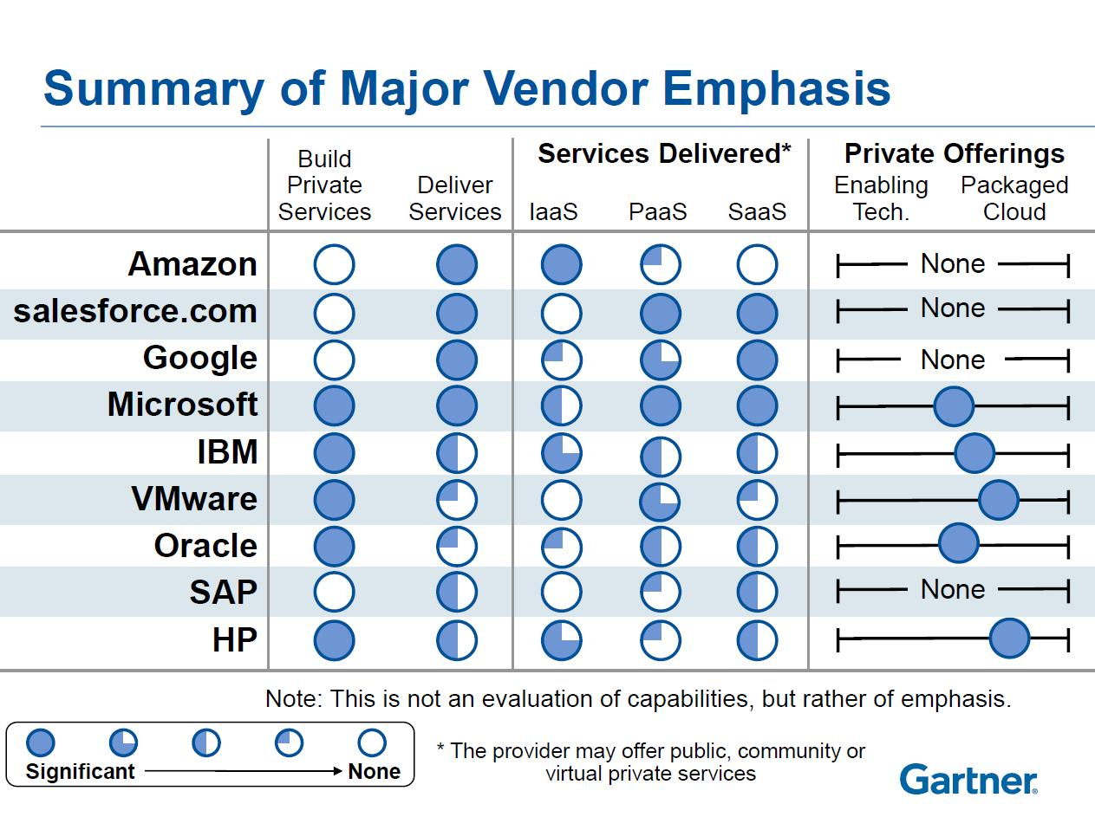

Slide 18
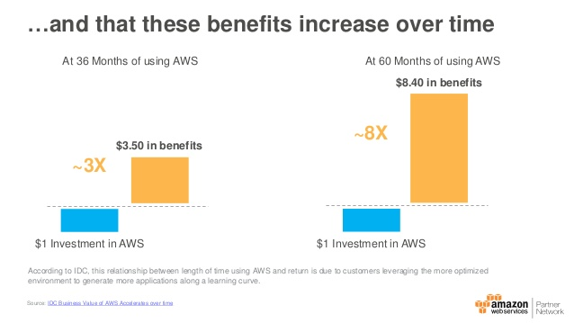
TCO / ROI Models
Models the total cost of ownership for running an infrastructure environment
TCO is used to :
Compare the costs of running an entire infrastructure environment
The cost of specific workload
Build the business case for migration

Slide 19
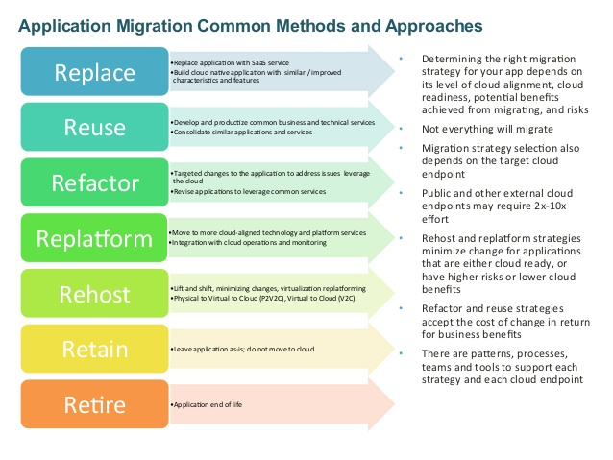
SaaS
Divide App
Alter App
Different Cloud
Lift and Shift to Cloud
No Migration
Remove Service

Slide 20
Design Patterns in Cloud Computing
Sharing, Scaling and Elasticity Patterns
Reliability, Resiliency and Recovery Patterns
Data Management and Storage Device Patterns
Virtual Server and Hypervisor Connectivity and Management Patterns
Monitoring, Provisioning and Administration Patterns
Cloud Service and Storage Security Patterns
Network Security, Identity & Access Management and Trust Assurance Patterns
Common Compound Patterns

Slide 21




Resource Pooling Pattern
Goals:
Organize IT resources
Support Dynamic Sharing
CPU pool
Memory pool
Storage pool
Network pool

Slide 22
Resource Pooling Pattern Cont’d
Problem:
Need of synchronization
When assembling IT resources
Need of more attention in sharing and scalability purposes
Shared Resources
Dynamic scalability
Challenges in manually maintaining the level of synchronicity in collections of shared IT resources

Slide 23
Resource Pooling Pattern
Solution:
Grouping IT resources into Resource Pools
Maintaining by an Automatic System to remain synchronized
CPU pool
Memory pool
Storage pool
Network pool

Slide 24
Resource Pooling Pattern
Application:
Establish a Reliable Synchronization System
Support of Shared Resources
Support of Dynamic Scalability
Can be further supported by the application of Resource Reservation Pattern
Storage pool

Slide 25

Resource Pooling Pattern
Application:
Networked servers with OS and other applications
Ubuntu Servers with
2 Gigabytes of RAM
Empty or ﬁlled
Cloud Storage Devices.
Physical Server pool
Virtual Server pool
Storage pool
Network pool
CPU pool
Memory pool
A pool of virtual ﬁrewall devices
Processor Pools to be allocated to Virtual Servers
Memory Pools used in
physical servers

Slide 26
Resource Pooling Pattern
Application:
Pool A
Pool B
Shared Pools B and C are sibling pools taken from the larger Pool A
Pool C

Slide 27
Resource Pooling Pattern
Application:
Pool A
Pool A.1
Nested Pools A.1 and A.2 are comprised of the same IT resources as Pool A, but in different quantities
Pool A.2

Slide 28



Resource Reservation Pattern
Goals:
Protect IT resources from conﬂicts of Concurrent Access
Pool A
Pool B

Slide 29
Resource Reservation Pattern
Problem:
Multiple cloud service consumers may access to the same IT resources
Resource Constraint exception:
Several consumers share an IT resource with no capacity for processing requirements
Result: degraded performance or rejection
Resource Borrowing exception:
One pool temporarily borrows IT resources from other pools

Slide 30
Resource Reservation Pattern
Solution:
IT resource Reservation System
Guarantees a minimum amount of an IT resource for each consumer
Exclusively available only to the designated cloud consumer
Solve resource constraints and resource borrowing
The reserved IT resources are never actually shared!

Slide 31

Resource Reservation Pattern
Application:
1. Resource Pooling
Pool A
Pool B
2. Smaller Child
Pools Creation
3. Consumers access to their own exclusive pools
Cloud Consumer A
Cloud Consumer B

Slide 32
Resource Reservation Pattern
Application:
Pool A
Pool B
7. Borrow resources from Pool B with limit deﬁnition to avoid constraint
5. Increase in requests from Cloud Consumer A
6. More resources allocation
Cloud Consumer A
Cloud Consumer B

Slide 33
Resource Reservation Pattern
Application:
Pool A
Pool B
9. Release borrowed resources by the Resource Management System
8. Increase in requests from Cloud Consumer B and more IT resources allocation
Cloud Consumer A
Cloud Consumer B

Slide 34
Hypervisor Clustering Pattern
Goals:
Virtual Servers should survive the failure of its hosting Hypervisor/physical server
Virtual Server A
Virtual Server B
Hypervisor
Physical Server A

Slide 35
Hypervisor Clustering Pattern
Problem:
Hypervisor: an application to create and run virtual servers
Failure of hypervisor or underlying physical server:
Cascades to all of its hosted virtual servers

Slide 36
Hypervisor Clustering Pattern
Problem:
Virtual Server A
Virtual Server B
Virtual Server A
Virtual Server B
Hypervisor
Hypervisor
Physical Server A
Physical Server A

Slide 37
Hypervisor Clustering Pattern
Solution:
Create High-availability Hypervisor Clusters
Failure of physical server or hypervisor
Move Virtual Servers to another Physical Server or hypervisor
Virtual Server A
Virtual Server A
Hypervisor
Hypervisor
Physical Server A
Physical Server B

Slide 38
Hypervisor Clustering Pattern
Application:
Hypervisor Cluster control via a central VIM
Sends regular heartbeat messages to the hypervisors
Check if running and up
Fail to acknowledge:
Initiate the live VM migration program
Move affected virtual servers to a new host

Slide 39
Hypervisor Clustering Pattern
Application:
3. A public Access Shared storage device containing Virtual Server conﬁgurations
Virtual Server A
Virtual Server B
Virtual Server C
Virtual Server D
Virtual Server E
2. Virtual Servers are created by the Hypervisors
Hypervisor
Hypervisor
Hypervisor
1. Hypervisors installed on Physical Servers
Physical Server A
Physical Server B
Physical Server C
Virtual Infrastructure Manager
4. The Hypervisor Cluster is enabled on physical server hosts via a Central VIM

Slide 40
Hypervisor Clustering Pattern
Application:
Virtual Server A
Virtual Server B
Virtual Server C
Virtual Server D
Virtual Server E
Hypervisor
Hypervisor
Hypervisor
Physical Server A
Physical Server B
Physical Server C
Virtual Infrastructure Manager
5. The Physical Servers exchange heartbeat messages with each other and the VIM

Slide 41
Hypervisor Clustering Pattern
Application:
Virtual Server A
Virtual Server B
Virtual Server C
Virtual Server D
Virtual Server E
Hypervisor
Hypervisor
Hypervisor
6. Physical Server B fails which leads to C failure
Physical Server A
Physical Server B
Physical Server C
Virtual Infrastructure Manager
7. VIM and the other physical servers stop receiving heartbeat messages from
Physical Server B

Slide 42
Hypervisor Clustering Pattern
Application:
9. Virtual Server C is migrated to the hypervisor running on Physical Server C
Virtual Server A
Virtual Server B
Virtual Server C
Virtual Server D
Virtual Server E
Hypervisor
Hypervisor
Hypervisor
Physical Server A
Physical Server B
Physical Server C
Virtual Infrastructure Manager
8. VIM chooses Physical Server C as the new host of Virtual Server C

Slide 43
Redundant Storage Pattern
Goals:
Reliability and availability of cloud storage devices survival in failure conditions

Slide 44
Redundant Storage Pattern
Problem:
Failure of cloud storage devices
Network connectivity issues
Controller failures
General hardware failure
Security breaches
Effects of failure across
Cloud services
Cloud-based applications
Cloud infrastructure

Slide 45
Redundant Storage Pattern
Problem:
2. Different LUNs created, one for each customer
4. Cloud consumer requests are forwarded to respective LUNs
1. Storage device is installed and configured
3. Customers requests for accessing their LUNs to R/W

Slide 46
Redundant Storage Pattern
Problem:
5. Costumers lose access to LUNs and stored data
5.1 Maybe because of
Storage failure
5.2 Or user connectivity

Slide 47
Redundant Storage Pattern
Solution:
A Secondary Redundant Storage Device
Synchronizes its data with the data in the primary cloud storage device
1. The Primary Storage Device is replicated to the Secondary Storage Device

Slide 48
Redundant Storage Pattern
Solution:
A Secondary Redundant Storage Device
Synchronizes its data with the data in the primary cloud storage device
2. When the Primary Storage becomes unavailable, the Secondary Storage forwards the requests to the LUNs

Slide 49
Redundant Storage Pattern
Application:
Uses Resource Replication Mechanism to keep the primary storage device synchronized
Usually locate Secondary cloud storage devices in a different geographical region than the primary one
May dictate the protocol of synchronization
Some replication transport protocols have Distance Restrictions

Slide 50
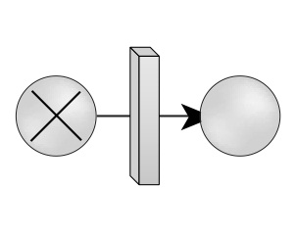

Dynamic Failure Detection and Recovery
Goals:
Improve and Auto Correct failures

Slide 51
Dynamic Failure Detection and Recovery
Problem:
cloud-based IT resources Fail
manual intervention unacceptable

Slide 52


Dynamic Failure Detection and Recovery
Solution:
Watchdog Monitor
Watchdog System

Slide 53

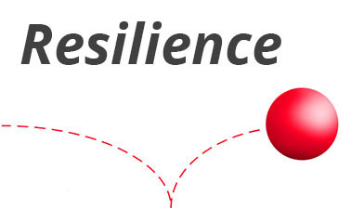

Dynamic Failure Detection and Recovery
Application:
Intelligent Watchdog Monitor
Resilient Watchdog System

Slide 54
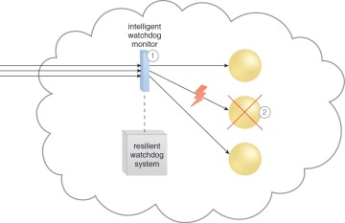
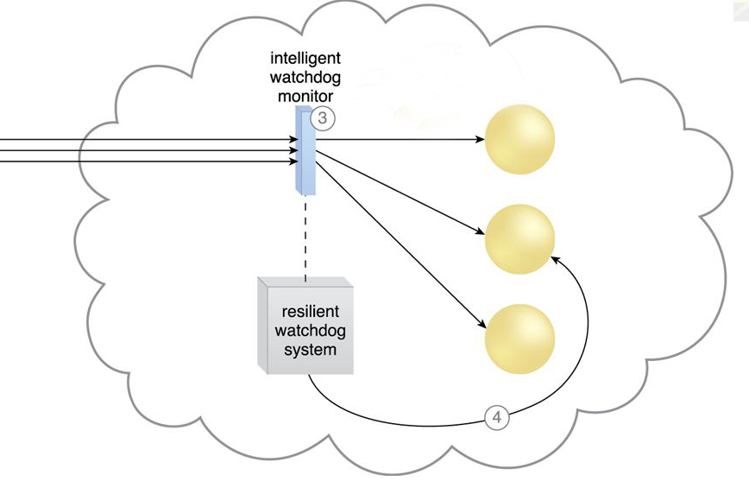
Dynamic Failure Detection and Recovery
Application:

Slide 55


Dynamic Failure Detection and Recovery
Application:
Watching
Deciding upon an event
Acting upon an event
Reporting
Escalating

Slide 56
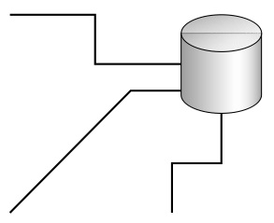
Multipath Resource Access
Goals:
Access to the Source is Unavailable or Lost

Slide 57
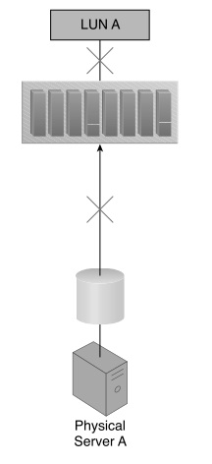
Multipath Resource Access
Problem:
Access to resources Inadvertently lost path Incorrectly defined path

Slide 58
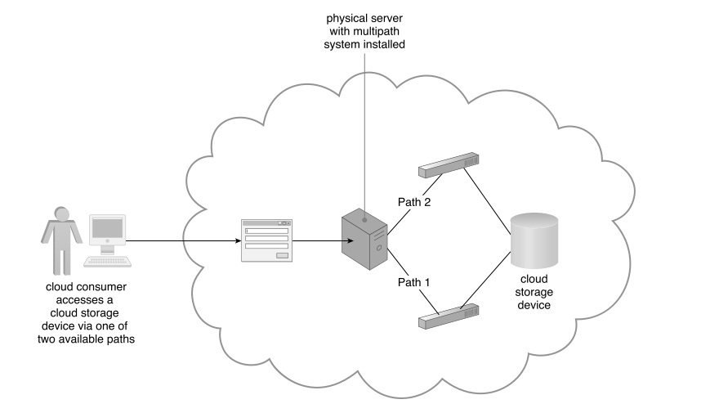
Multipath Resource Access
Solution:
Alternative paths (multi patching system) Programmatically Manually

Slide 59
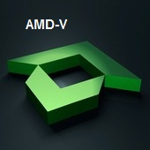
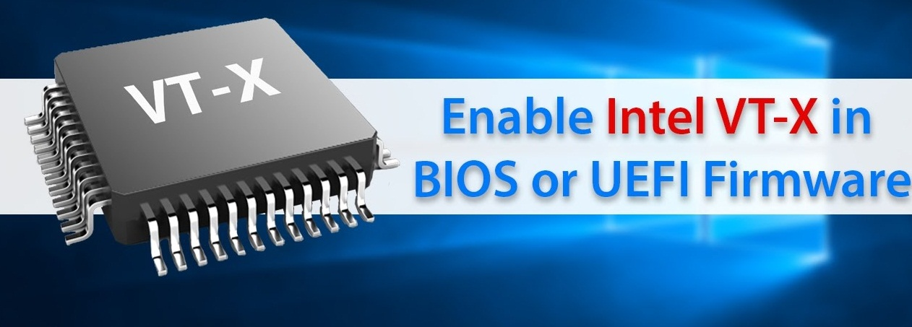
Multipath Resource Access
Application:
Multi pathing system Resides on the Server hypervisor

Slide 60
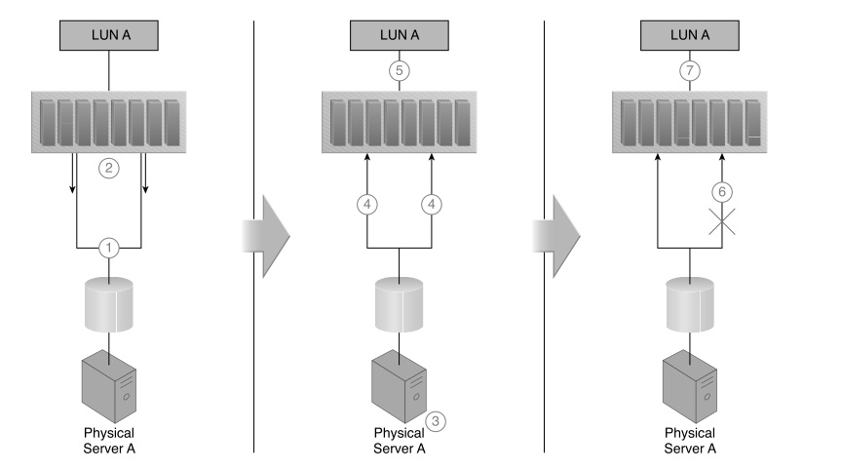
Multipath Resource Access
Application:

Slide 61
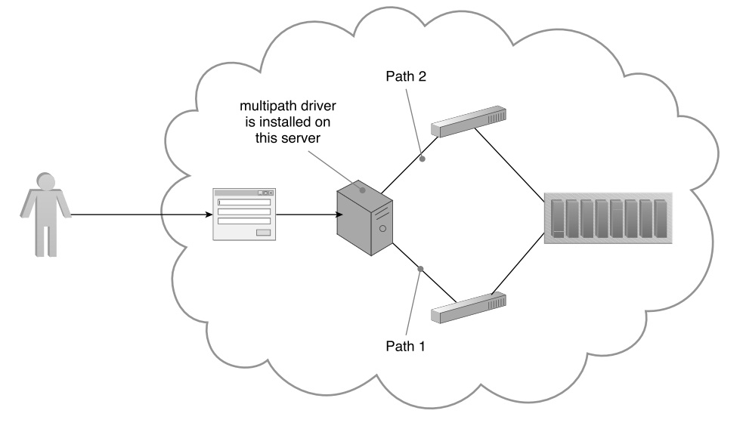
Multipath Resource Access
Application:
Driver Installed On Server

Slide 62


Redundant Physical Connection for Virtual Servers
Goals:
Certainty associated with the network Cable disconnection or Port failure

Slide 63
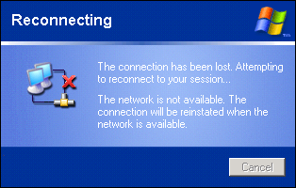
Redundant Physical Connection for Virtual Servers
Problem:
virtual server : isolated or Disconnect

Slide 64
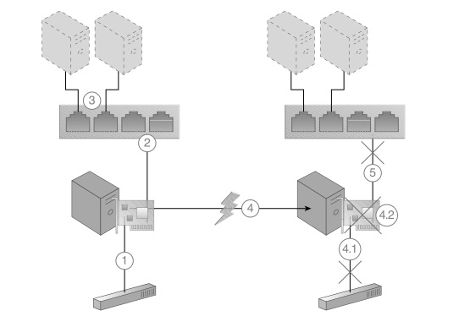
Redundant Physical Connection for Virtual Servers
Problem:

Slide 65
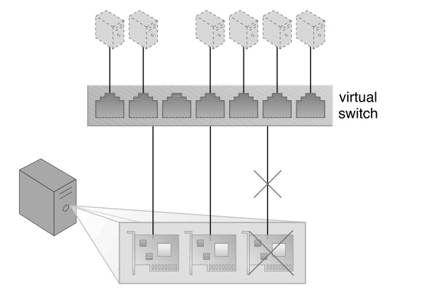
Redundant Physical Connection for Virtual Servers
Solution:
physical backup network connection

Slide 66
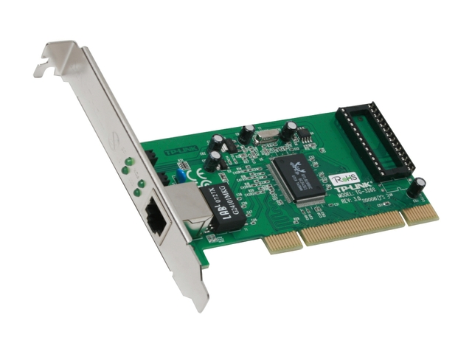
Redundant Physical Connection for Virtual Servers
Application:
A second Physical Network Card

Slide 67
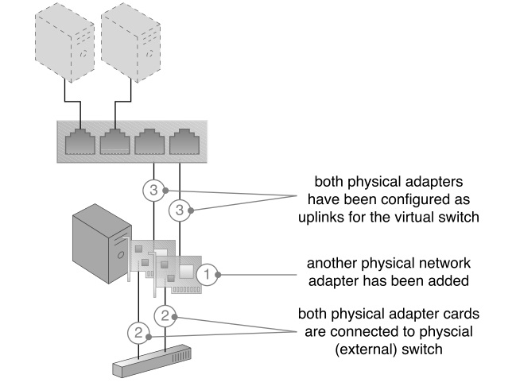
Redundant Physical Connection for Virtual Servers
Application:

Slide 68
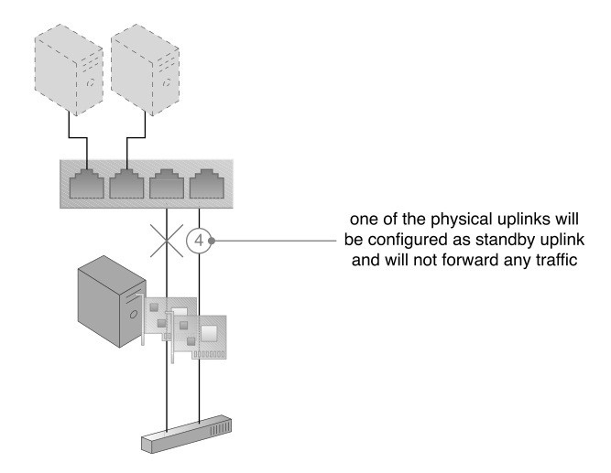
Redundant Physical Connection for Virtual Servers
Application:

Slide 69
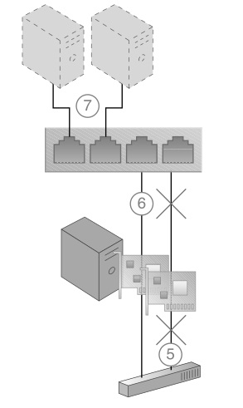
Redundant Physical Connection for Virtual Servers
Application:

Slide 70

Synchronized Operating State
Goals:
Use high availability and clustering technology by the consumer

Slide 71


Synchronized Operating State
Problem:
Lack of productivity of the consumer Technical restrictions licensing restrictions other reasons

Slide 72
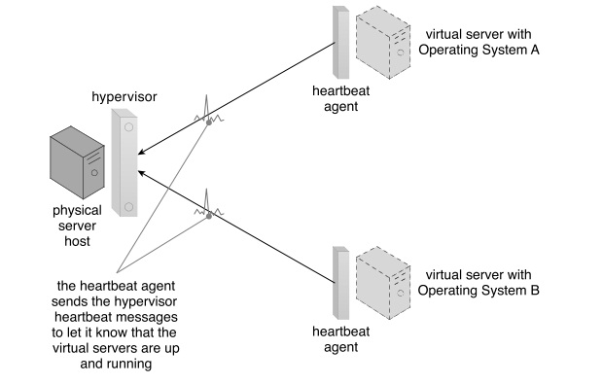
Synchronized Operating State
Solution :
Use of Heartbeat Message

Slide 73
Synchronized Operating State
Application :
Cloud Storage Device
Failover System
Hypervisor
Resource Replication
State Management Database
Virtual Server

Slide 74
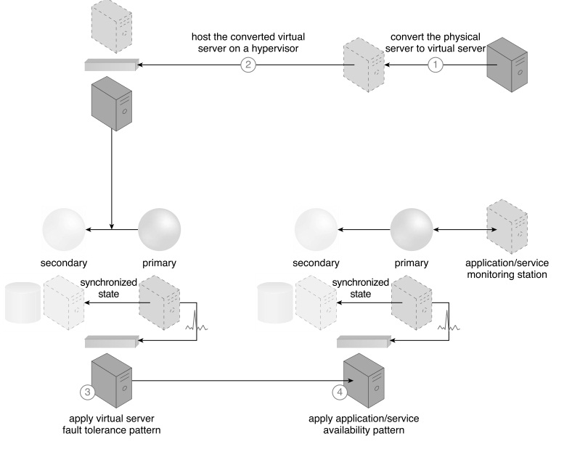
Synchronized Operating State
Application :

Slide 75
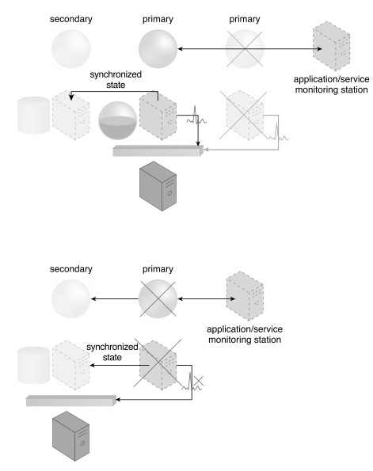
Synchronized Operating State
Application :

Slide 76



References
Cloud Computing Design Patterns By Robert Cope and Amin NaserPour
Lynda.com (Learning Cloud Computing Core Concepts By David Linthicum)
Design Pattern in Cloud Computing , 2015 10th International Conference on P2P, Parallel, Grid, Cloud and Internet Computing

